Slide 1
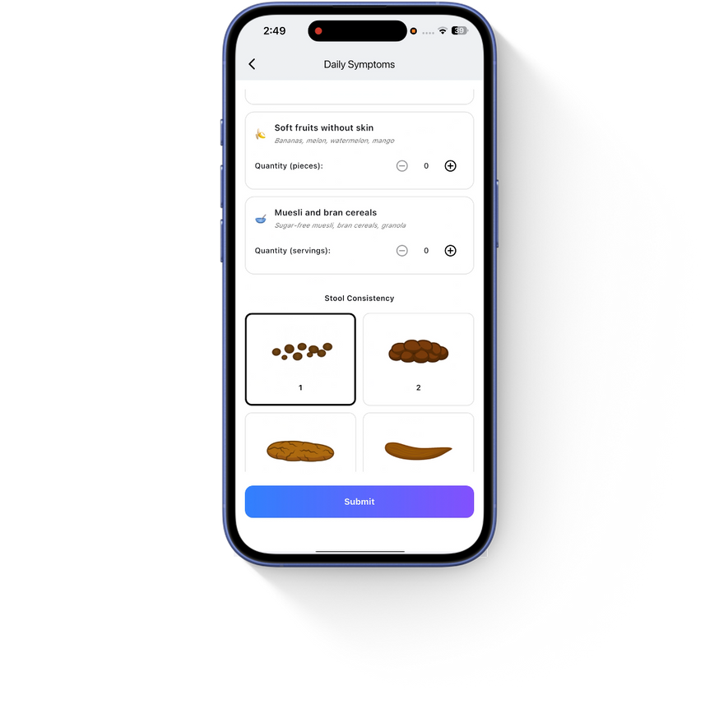
iLARS
SMART SUPPORT FOR LIFE AFTER RECTAL SURGERY.

Slide 2

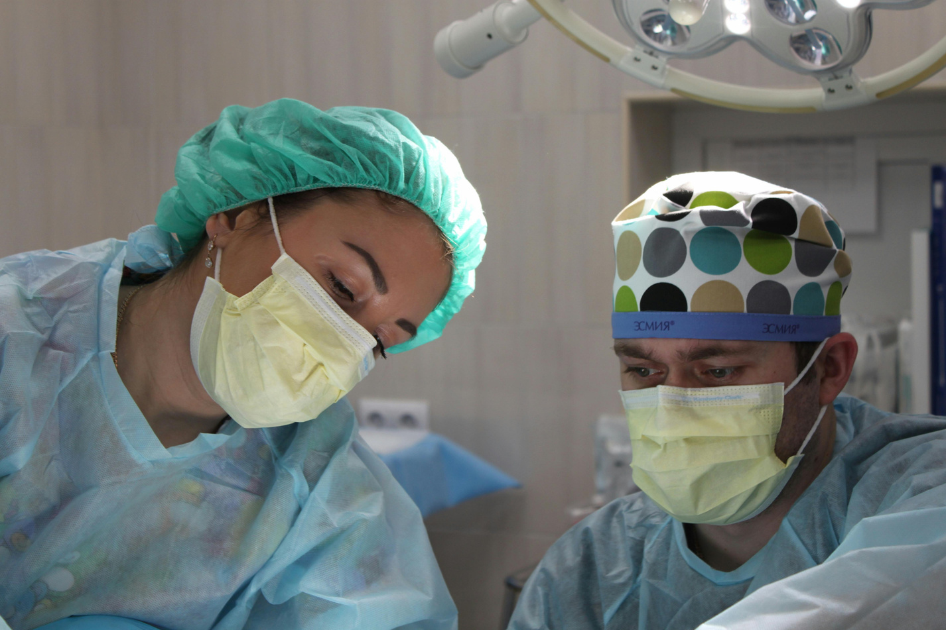
The problem
❌ No easy way for patients to track daily symptoms
❌ Important information often lost between visits
❌ Lack of structured, longitudinal data
❌ No digital tools tailored specifically to LARS

Slide 3
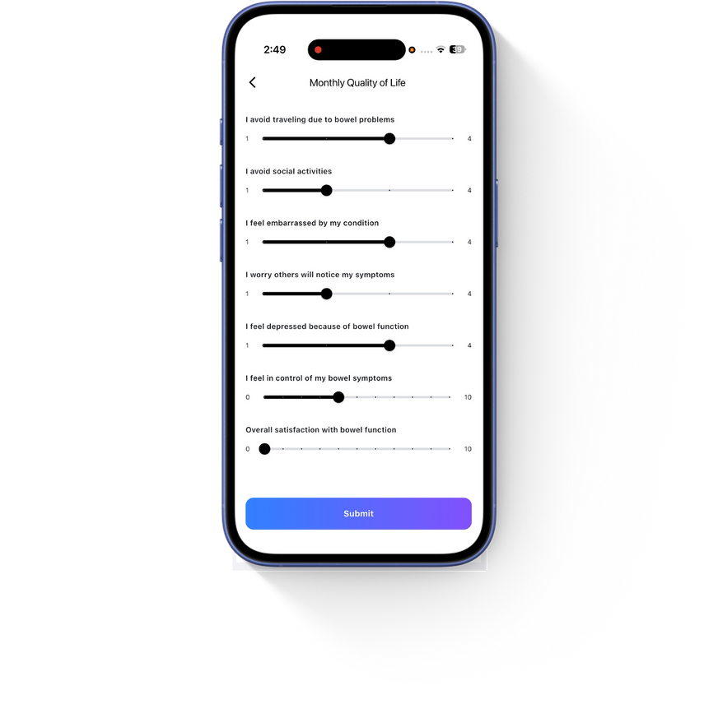

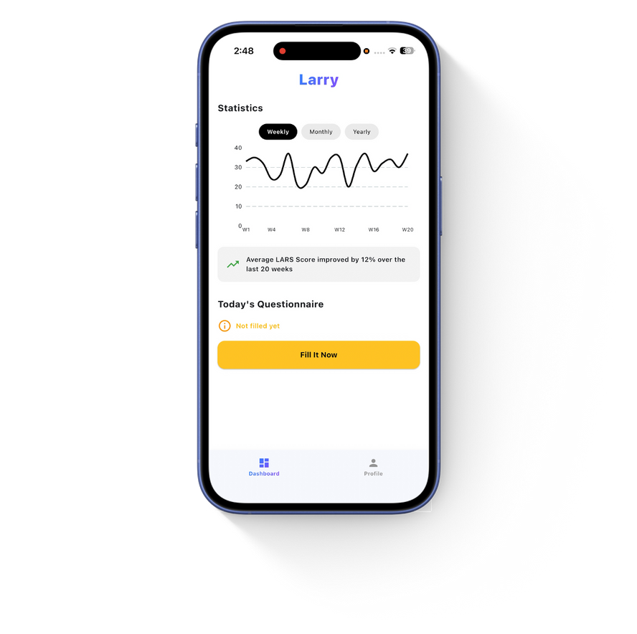
Our best solution
✔ Daily symptom tracking
✔ LARS & Wexner score calculators
✔ Stool diary (Bristol scale)
✔ Daily diet logging
✔ Pelvic floor & diet education
✔ Trend visualization & exportable PDF reports

Slide 4

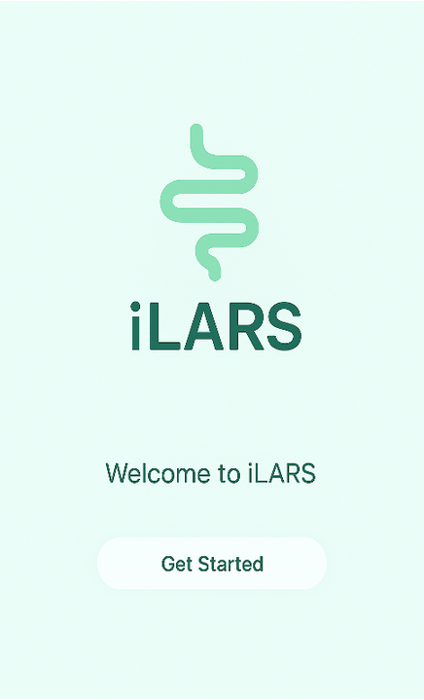
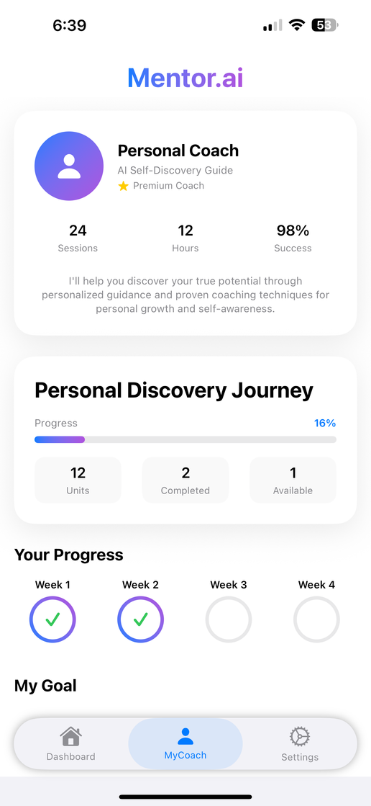
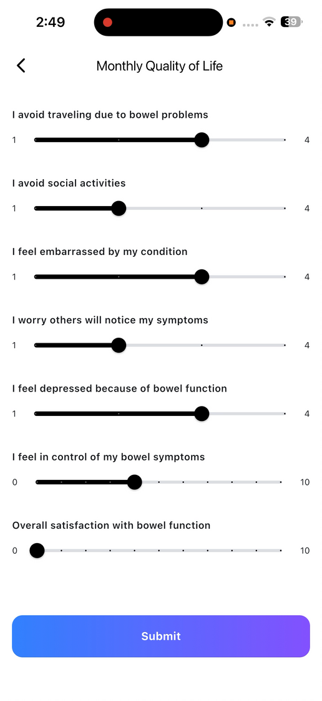
Simple. Intuitive.
Daily use in 1–2 minutes.
•Easy onboarding – individualized codes
•Track bowel habits and symptoms
•Monitor progress via charts and scores
•Share reports with your physician
•Education for diet, exercises, and more

Slide 5
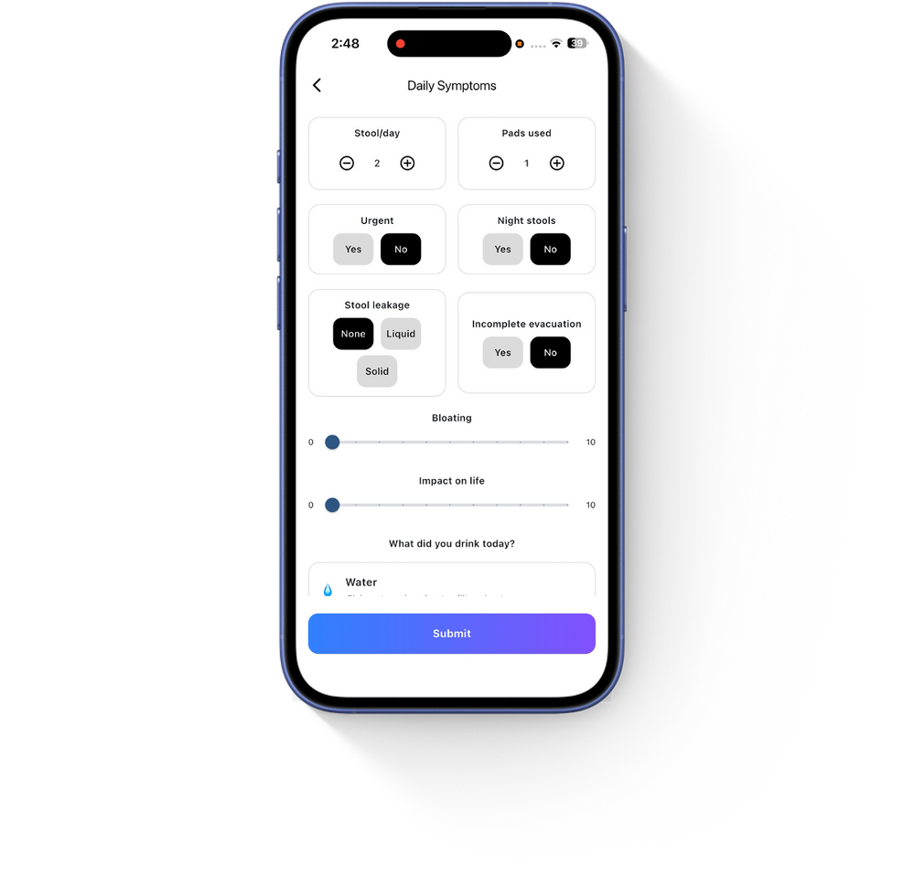
Benefits for Physicians
• See validated scores and symptom trends over time
• Quickly identify worsening LARS or non-response
• Discuss objective symptom data during follow-up
• Save time and improve personalized care
• Potential integration into EMRs or registries

Slide 6




What’s next?
Integrating alerts & AI suggestions
Pilot testing with patients
Multilingual interface
Collaborators for testing

Slide 7



Dovile Cerkauskaite, M.D.
Benedikt Bachmetjev, M.D.
Audrius Dulskas, M.D., PhD
“
PROJECT IDEA AND CLINICAL CONCEPT; SYMPTOM MODULES, EDUCATIONAL CONTENT, AND APP TEXTS; COORDINATION AND COLLABORATION WITH DEVELOPER
“
“
CLINICAL CO-DESIGN AND TECHNICAL LEAD; APP DEVELOPMENT: DESIGN, CODING, FULL-STACK INFRASTRUCTURE
“
“
CLINICAL FEEDBACK AND USABILITY; ASSESSED INTERFACE FROM PHYSICIAN’S PERSPECTIVE; CONTRIBUTED TO LOGIC AND DECISION FLOW
“

Slide 8
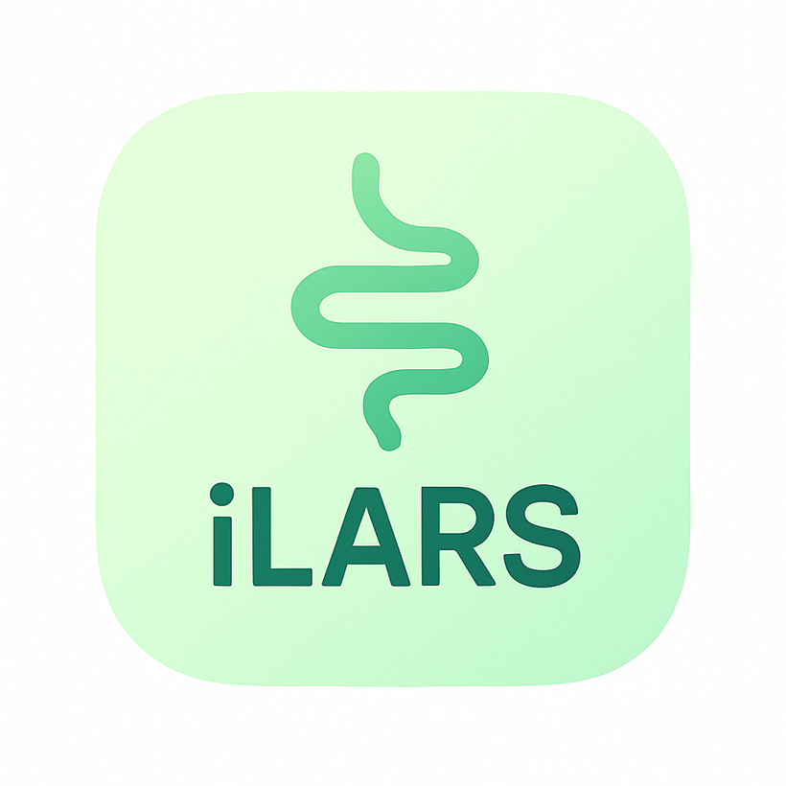

INTERESTED? LET’S GET IN TOUCH!
SMART SUPPORT FOR LIFE AFTER RECTAL SURGERY.

